Slide 1
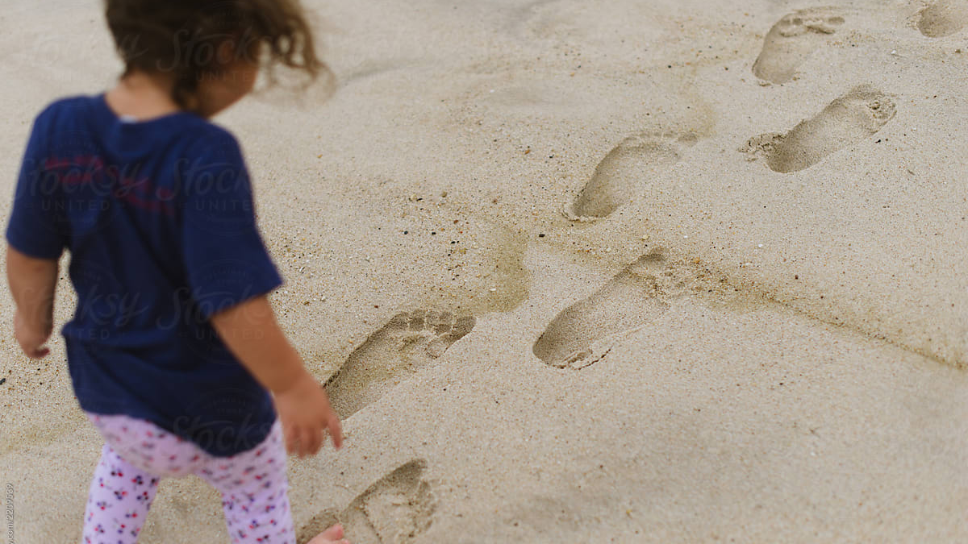
Parenting –Week 1 – Imitation and roles

Slide 2
Agenda
Discussion – What’s Your Struggle? Follow Me Roles Q&A

Slide 3

What challenges are you facing?

Slide 4
Follow Me
Your parenting struggles begin with you

Slide 5
Paul called Timothy his “beloved child”
2 Timothy 3:10–11 (ESV)
10 You, however, have followed my teaching, my conduct, my aim in life, my faith, my patience, my love, my steadfastness, 11 my persecutions and sufferings that happened to me...

Slide 6
Parenting begins with saying “follow my example”
Teaching
Conduct
Aim in Life
Faith
Patience
Love
Steadfastness
Persecutions
Sufferings
1 Corinthians 11:1 (NIV)
“Follow my example, as I follow the example of Christ.”

Slide 7
Parenting struggles begin in the inner life
When you can’t confidently call your children to follow your example as you follow the example of Christ, your parenting begins to break down.

Slide 8

How might this look in your life?
Notes:
Some Examples:
Can’t enforce discipline because of hurt from your childhood.
You fear your child rejecting you if you exercise authority.
You don’t want to give the necessary time to your children because you are selfish.
You hesitate to call your child to follow Christ because you are not following him.
You feel guilty because of your failures and anger, making correcting your child’s anger and disobedience difficult.

Slide 9

Growth in parenting begins with growth in Christ and the gospel.
Notes:
Start taking your sin, failures, and hurts to the cross.
Repent, ask for forgiveness, and seek healing.
Also, repent to your children.

Slide 10
Aim for humility and love instead of perfection.
1 Peter 4:8 (ESV)
8 Above all, strive to love one another deeply, for love conceals a multitude of sins.
Colossians 3:12–14 (ESV) 12 Therefore, as God’s chosen people, holy and dearly loved, clothe yourselves with compassion, kindness, humility, gentleness, and patience. 13 Bear with each other and forgive one another if any of you has a grievance against someone. Forgive as the Lord forgave you. 14 And over all these virtues, put on love, which unites them all in perfect harmony.
Notes:
If you feel the pressure of perfection, you will withdraw, attack, defend, and constantly feel like a failure.
If you embrace the cross, you will lead your child straight to Christ!

Slide 11
Roles
Father, Mother, Husband, Wife, Son, or Daughter

Slide 12
Parenting well requires understanding your role
What is your role as a parent?
Notes:
Teacher
Disciple-maker
Discipliner
Represent God’s authority
Recipient of obedience and honor

Slide 13
You are a source of life and blessing to your child (if they learn to honor you).
Exodus 20:12 (ESV)
12 “Honor your father and your mother, that your days may be long in the land that the Lord your God is giving you.”
Notes:
You represent God’s authority. We will get to this more in a few minutes.

Slide 14
You are your child’s teacher.
Proverbs 1:8–10 (ESV)
8Hear, my son, your father’s instruction, and forsake not your mother’s teaching,
9for they are a graceful garland for your head and pendants for your neck.
10My son, if sinners entice you, do not consent.
Notes:
You see here a primary part of your teaching is to stay away from sin.

Slide 15
You are your child’s authority.
Ephesians 6:1–4 (ESV)
Children, obey your parents in the Lord, for this is right. 2 “Honor your father and mother” (this is the first commandment with a promise), 3 “that it may go well with you and that you may live long in the land.” 4 Fathers, do not provoke your children to anger, but bring them up in the discipline and instruction of the Lord.
Notes:
Don’t be shy.

Slide 16
Parenting well requires understanding your role
What is your role as a spouse?
Notes:
Husbands?
Wives?

Slide 17
Wives, submit to your husbands and respect your husbands.
Ephesians 5:22–33 (ESV)
22 Wives, submit to your own husbands, as to the Lord. 23 For the husband is the head of the wife even as Christ is the head of the church, his body, and is himself its Savior. 24 Now as the church submits to Christ, so also wives should submit in everything to their husbands.
Notes:
What does this look like?

Slide 18
Husbands, love your wives like Christ loves us. Lay down your life for them, lead them with the Word of God, take care of them.
Ephesians 5:22–33 (ESV)
25 Husbands, love your wives, as Christ loved the church and gave himself up for her, 26 that he might sanctify her, having cleansed her by the washing of water with the word, 27 so that he might present the church to himself in splendor, without spot or wrinkle or any such thing, that she might be holy and without blemish. 28 In the same way husbands should love their wives as their own bodies. He who loves his wife loves himself. 29 For no one ever hated his own flesh, but nourishes and cherishes it, just as Christ does the church, 30 because we are members of his body. 31 “Therefore a man shall leave his father and mother and hold fast to his wife, and the two shall become one flesh.” 32 This mystery is profound, and I am saying that it refers to Christ and the church. 33 However, let each one of you love his wife as himself, and let the wife see that she respects her husband.
Notes:
What does this look like?

Slide 19
How has your understanding of your role as a husband or wife affected your parenting?
Notes:
Refusal to submit to Christ as a husband has created frustration or rebellion in the home.
A wife won’t respect her husband and has raised disrespectful children.
The husband is selfish, ignoring his wife and living for himself. The children start to treat the mom the same way.
The wife won’t accept her role as under the authority of the husband, throwing off the God-given authority structure in the home. This makes it hard for the father to walk in his calling to lead.

Slide 20

Q&A

Slide 21

Parenting –Week 2 – Special Topics in parenting

Slide 22
Agenda
Intersection of marriage and parenting
Respect and discipline
Your relationship with your children Q&A

Slide 23
The Intersection of Marriage and Parenting

Slide 24
Marriage and Children
Relationship before Children
Husband
Wife
Relationship after Children
Husband
Wife
Child
Notes:
Complexity increases
Your relationship to each other affects your children
Your relationship with your child affects your marriage

Slide 25
Struggles from last week
How do we handle a disagreement with our spouse about a parenting issue?
How do we decide how many kids to have?
Notes:
What’s the nature of the disagreement?
Is your home in order (husband leading and wife submitting)?
What’s the underlying issue behind the disagreement?
1 more than you are comfortable with!
Be fruitful and multiply is the command – God’s blessing will follow – don’t let selfishness or money make the decision

Slide 26
Respect and Discipline
Notes:
A lot of the struggles mentioned last week revolved around these two things

Slide 27
Proverbs 22:6
“Train up a child in the way he should go; even when he is old he will not depart from it.”

Slide 28
Ephesians 6:1-4
“Honor your father and mother” (this is the first commandment with a promise), “that it may go well with you and that you may live long in the land.” Fathers, do not provoke your children to anger, but bring them up in the discipline and instruction of the Lord.

Slide 29
Proverbs 19:18
Discipline your son, for there is hope; do not set your heart on putting him to death.

Slide 30
Proverbs 13:24
Whoever spares the rod hates his son, but he who loves him is diligent to discipline him.

Slide 31
Proverbs 22:15
Folly is bound up in the heart of a child, but the rod of discipline drives it far from him.

Slide 32
Proverbs 29:15
The rod and reproof give wisdom, but a child left to himself brings shame to his mother.

Slide 33
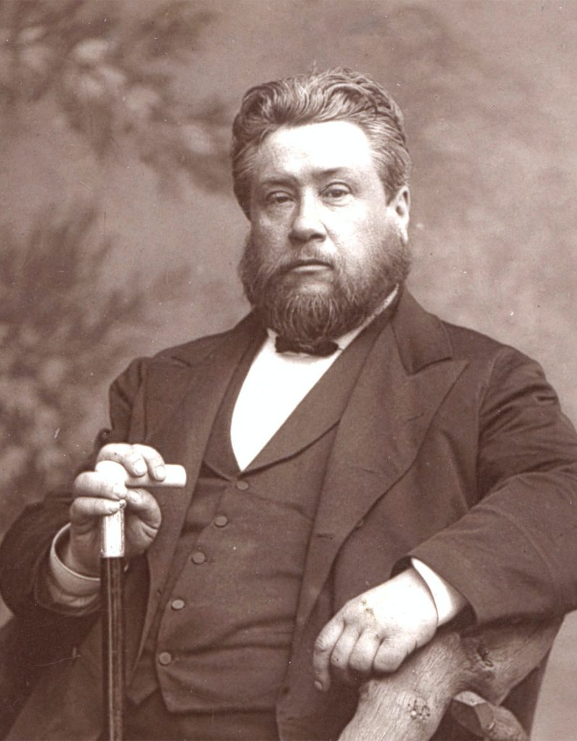
Charles Spurgeon
“If we never have headaches through rebuking our children, we shall have plenty of heartaches when they grow up.”

Slide 34
Consistent discipline and an environment of respect begin with confidence in God’s word
Notes:
Do you understand your role as a parent in your child’s life?
Do you believe implementing discipline as God’s word teaches will work?
Do you believe discipline is a sign of love and gives life?

Slide 35
Struggles from last week
Consistent discipline
Verbal vs. physical discipline
Teasing between siblings
Respect towards mom when Dad is not around
When to be compassionate vs. firm
Notes:
Why do you see compassion and firmness as opposites?

Slide 36
Your Relationship with Your Children

Slide 37
Hebrews 12:5-11
And have you forgotten the exhortation that addresses you as sons? “My son, do not regard lightly the discipline of the Lord, nor be weary when reproved by him. For the Lord disciplines the one he loves, and chastises every son whom he receives.” It is for discipline that you have to endure. God is treating you as sons. For what son is there whom his father does not discipline? If you are left without discipline, in which all have participated, then you are illegitimate children and not sons.

Slide 38
Hebrews 12:5-11
Besides this, we have had earthly fathers who disciplined us and we respected them. Shall we not much more be subject to the Father of spirits and live? For they disciplined us for a short time as it seemed best to them, but he disciplines us for our good, that we may share his holiness. For the moment all discipline seems painful rather than pleasant, but later it yields the peaceful fruit of righteousness to those who have been trained by it.
Notes:
We learn a lot about parenting from this passage
The end goal of all our parenting is this peaceful fruit of righteousness
What seems painful now is geared towards building a relationship with your child that will be peaceful as they grow up

Slide 39
To cultivate a friendship with your child in the future, it’s essential not to act as their friend during their early years. Instead, your role should be that of a parent.
Notes:
Do you understand your role as a parent in your child’s life?
Do you believe implementing discipline as God’s word teaches will work?
Do you believe discipline is a sign of love and gives life?

Slide 40
Struggles from last week
Secretiveness
Boys
Frustration when tired
Children’s friendships (extended family)
Confronting sin
Life transitions/next steps
Not repeating deep-rooted issues
Time Management
Notes:
Why do you see compassion and firmness as opposites?

Slide 41
Q&A

Slide 42
Parenting –Week 3 – Safeguarding the home

Slide 43
Agenda
Create the right kind of bubble
Recognize the threat
Lead your kids to Christ Q&A

Slide 44
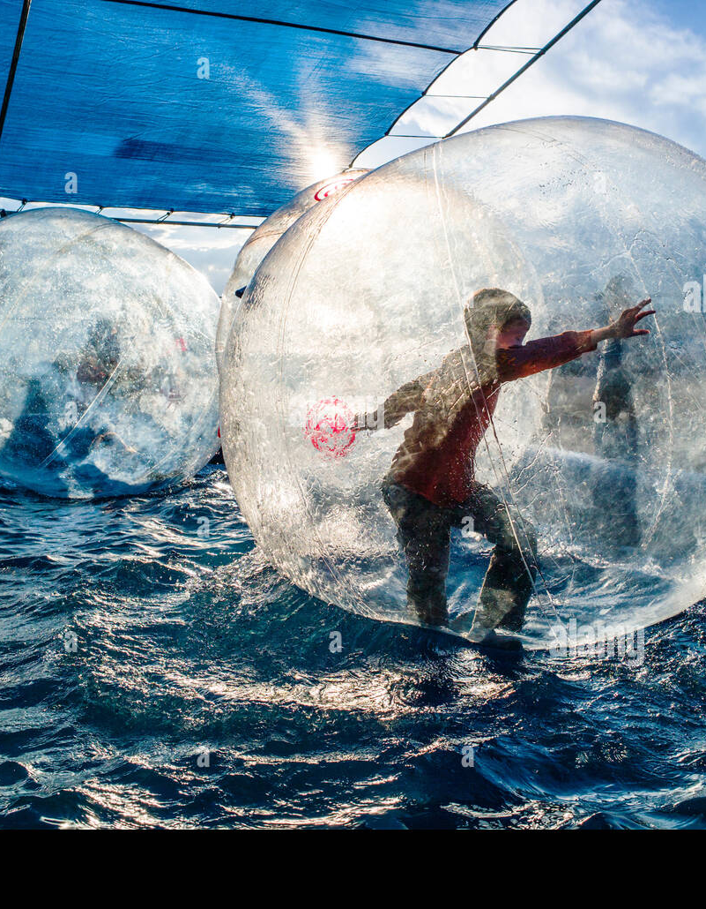
Create the Right Kind of Bubble
Notes:
A lot of the struggles mentioned last week revolved around these two things

Slide 45
Matthew 10:16
“Behold, I am sending you out as sheep in the midst of wolves, so be wise as serpents and innocent as doves.” - Jesus

Slide 46
1 Corinthians 14:20
“Brothers, do not be children in your thinking. Be infants in evil, but in your thinking be mature.”

Slide 47
Romans 16:19
“For your obedience is known to all, so that I rejoice over you, but I want you to be wise as to what is good and innocent as to what is evil.”

Slide 48

The wrong kind of bubble
Real World
Playing Outside
Romantic Attachments
Internet and gaming
Friendships
Extended family
Church family
Naivete
Pretend realities of life don’t exist
All Strangers
Experiencing Failure
Safe if at home
Fear, worry, and anxiety
Realistic view of unsaved humanity
Highly filtered ideas
Harsh realities of a fallen world
All Christians can be trusted
Notes:
Complexity increases
Your relationship to each other affects your children
Your relationship with your child affects your marriage

Slide 49
The right kind of bubble
Evil
Unsafe people
Abusers
Discernment
Sinful influences
Truth
Wisdom
Age-appropriate awareness
Knowledge of the Bible
Sexual predators (online and in-person)
Unhealthy romantic relationships
Acknowledgment of weaknesses
Gospel and grace
Content and conversation not suitable for age
Destructive online habits
Biblical Worldview
Approachable Parents
Drugs, Alcohol, sex outside of marriage
Know right from wrong
Trust God and Parents
Corrupting content and ideas
Honest about the perils of the world
Addictive substances and activities
Foolishness
Notes:
Complexity increases
Your relationship to each other affects your children
Your relationship with your child affects your marriage

Slide 50
Recognize the Threat
Notes:
A lot of the struggles mentioned last week revolved around these two things

Slide 51
Proverbs 22:3
“The prudent sees danger and hides himself, but the simple go on and suffer for it.”

Slide 52

Julie Lowe
“Too often parents are unwilling to face the realities of the perils that exist in the world around us, and therefore conceal such realities from their children. But if we only shelter our children and do not equip them to act in wisdom, we inadvertently raise naïve, simple children who do not know how to make sense of evil and wisely navigate it.”

Slide 53
Primary threats: screens, internet, Social Media, and pornography
Notes:
Do you understand your role as a parent in your child’s life?
Do you believe implementing discipline as God’s word teaches will work?
Do you believe discipline is a sign of love and gives life?

Slide 54

Phone-based childhood
“So, when that salesman tells you that the product is free, you ask about the opportunity cost. How much time does the average child spend using the product? Around 40 hours a week for preteens like your daughter, he says. For teens aged 13 to 18, it’s closer to 50 hours per week. At that point, wouldn’t you walk out of the store?” (Haidt)

Slide 55
These are threats to boys and girls (from a sociologist’s point-of-view)
4 Big Categories:
Social Deprivation
Sleep Deprivation
Attention Fragmentation
Addiction

Slide 56
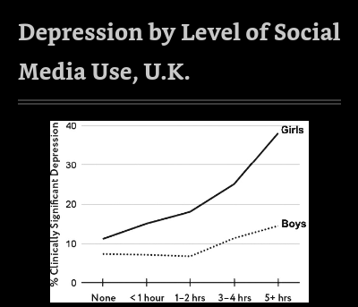
Social media use harms girls the most

Slide 57
Reasons girls are harmed more
Girls are more affected by visual social comparison and perfectionism
Girls’ aggression is more relational
Girls more easily share emotions and disorders (contagious negativity)
Girls are more subject to predation and harassment

Slide 58
What’s happening to boys?
“Young men in their late 20s are more likely to live with their parents (27% of them, in 2018), compared with young women (17%).[17] A more formal term is NEET, created by economists in the U.K. to refer to those between the ages of 16 and 24 who are Not in Education, Employment, or Training. Such young people are said to be “economically inactive.” NEETs in the U.K.[18] and the United States[19] are mostly men.” (Haidt)

Slide 59
The virtual world without “risk”
“As boys began to find fewer opportunities to exercise agency, develop friendships through risky play, and pursue unsupervised adventure in the increasingly overprotective real world, they found ever increasing opportunities to build agency and friendships in the virtual world.” (Haidt)

Slide 60
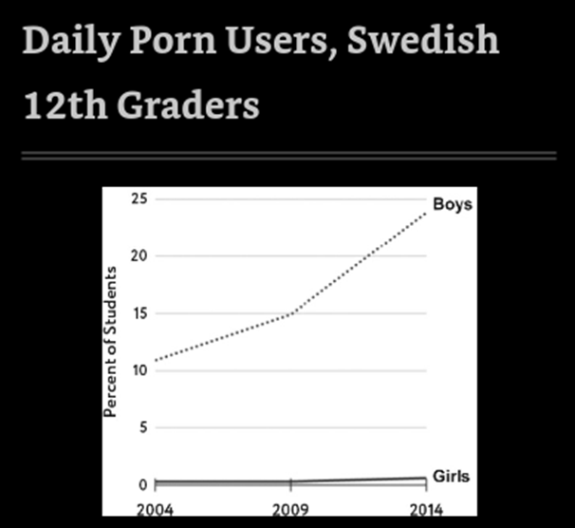

Slide 61
Alarming Stats about Porn
Dr. Anthony Bradley points out that 58% of males aged 15-24 have never approached a female.
They don’t even study the effects of pornography anymore among males in their 20s because they can’t find a control group big enough who doesn’t view it
The largest group of users of Internet porn are boys between the ages of twelve and seventeen. Porn producers increasingly target adolescents.
Porn is highly addictive.
Average first exposure happens at 12 years old and 93% of boys are exposed by age 18

Slide 62
Pornography hurts young men
Addiction
Turn to porn rather than engaging in the real world with women
Find real women less attractive
Experience lower sexual satisfaction
Separate sexual pleasures from a sexual relationship
Risks in the future are even greater with metaverse, spatial video, and generative AI.
Men are shying away from the risk of rejection
Notes:
Of course, Porn is sexual immorality and dishonors God, but I wanted to present the full spectrum of risks here.

Slide 63

Lead Your Kids to Christ
Notes:
A lot of the struggles mentioned last week revolved around these two things

Slide 64
Ephesians 2:1-10
“And you were dead in the trespasses and sins in which you once walked, following the course of this world, following the prince of the power of the air, the spirit that is now at work in the sons of disobedience— among whom we all once lived in the passions of our flesh, carrying out the desires of the body and the mind, and were by nature children of wrath, like the rest of mankind.

Slide 65
Ephesians 2:1-10
“But God, being rich in mercy, because of the great love with which he loved us, even when we were dead in our trespasses, made us alive together with Christ—by grace you have been saved— and raised us up with him and seated us with him in the heavenly places in Christ Jesus, so that in the coming ages he might show the immeasurable riches of his grace in kindness toward us in Christ Jesus. For by grace you have been saved through faith.

Slide 66
Ephesians 2:1-10
“And this is not your own doing; it is the gift of God, not a result of works, so that no one may boast. For we are his workmanship, created in Christ Jesus for good works, which God prepared beforehand, that we should walk in them.”

Slide 67
How to fight these battles
Teach your kids the Bible: all of it! Law and gospel.
Do not shy away from talking about hard topics
Create an environment of trust
Make it your goal to be the first voice they hear on the topic of sex and sexuality
Vigilantly guard your home
Notes:
All of the safeguards in the world won’t matter if they don’t love Jesus and fear God!
Hard conversations are not nearly as awkward as you think they are going to be.

Slide 68
Practical Tips
Router level controls and filters
Passwords on everything
Delay giving your kids a phone
Learn how to use iPhone or Android screentime controls
Limit all forms of screentime
Don’t become a radical separatist
Model what you want to see
Notes:
Router

Slide 69

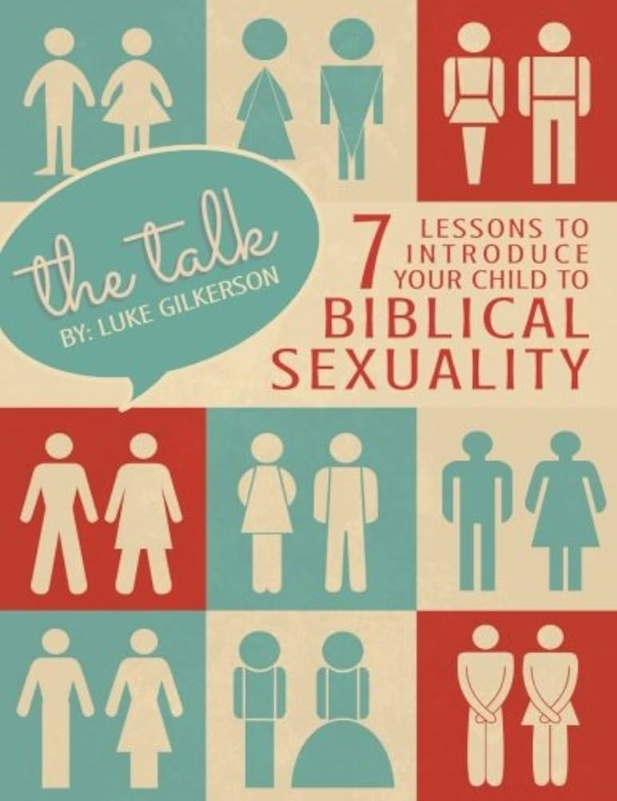

Resources
Notes:
Router

Slide 70
Q&A

